Slide 1
ENGINEERING CHEMISTRY - II
22CH203
Unit 4 – Lesson Plan 1

Slide 2
Catalysis
The process by which a substance speeds up a chemical reaction without being consumed in the process is catalysis.
The substance used is called “Catalyst”.
Dr Rameshkumar A/AP Chemistry

Slide 3
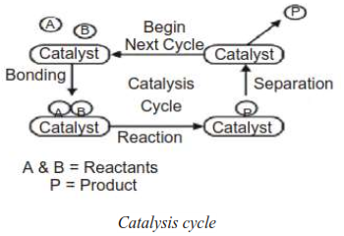
Catalysis cycle
Dr Rameshkumar A/AP Chemistry

Slide 4
Importance of Catalysis
Catalysts have many industrial uses, from the production of food products, biofuels, pharmaceuticals, plastics, and chemicals.
Most commercially produced chemicals are made with the help of catalysts. Some notable reactions enhanced by catalysis include production of sulphuric acid used for rust removal as well as a precursor for phosphoric acid, synthesis of ammonia, petroleum refining, and limiting of vehicle emissions.
Dr Rameshkumar A/AP Chemistry

Slide 5
Importance of Catalysis
During a chemical reaction, the bonds between the atoms in molecules are broken, rearranged, and rebuilt, recombining the atoms into new molecules. Catalysts make this process more efficient by lowering the activation energy.
Catalysts also have a key property called selectivity, by which they can direct a reaction to increase the amount of desired product and reduce the amount of unwanted by products.
Dr Rameshkumar A/AP Chemistry

Slide 6
Importance of Catalysis
Using catalysts leads to more energy-efficient chemical reactions.
Powerful catalysts have transformed the chemical industry. These advances have led to biodegradable plastics, new pharmaceuticals, and environmentally safer fuels and fertilizers.
Dr Rameshkumar A/AP Chemistry

Slide 7
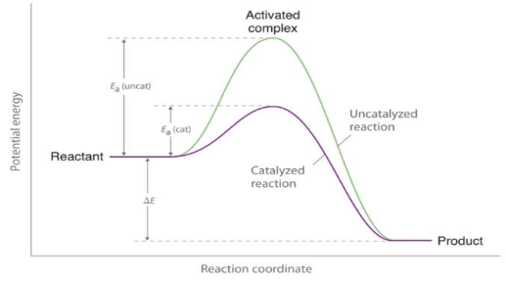
Role of a catalyst
Catalyst lowers the energy of activation (Ea) of a reaction.
Dr Rameshkumar A/AP Chemistry

Slide 8
Role of a catalyst
A catalyst does not appear in the overall stoichiometry of the reaction it catalyses, but it does have to exist in at least one of the elementary reactions in the catalysed reaction's mechanism.
The net change in energy (the difference between the energy of the reactants and the energy of the products) is unaffected by the presence of a catalyst.
At the same temperature, the reaction rate of a catalysed reaction is faster than that of an uncatalysed reaction due to its lower Ea.
Dr Rameshkumar A/AP Chemistry

Slide 9
Role of a catalyst
Catalysts do not just reduce the energy barrier, but induce a completely different reaction pathway typically with multiple energy barriers that must be overcome.
Because a catalyst lowers the energy barrier, it enhances the rate of forward and reverse reactions by the same amount in an equilibrium reaction.
Dr Rameshkumar A/AP Chemistry

Slide 10
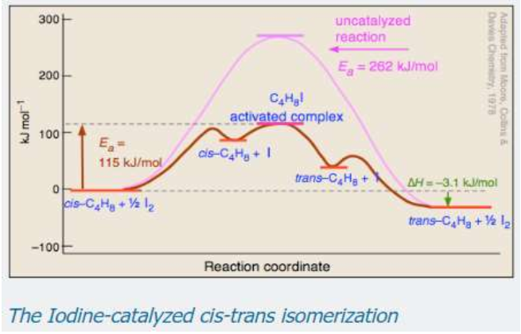
Role of a catalyst
Dr Rameshkumar A/AP Chemistry

Slide 11
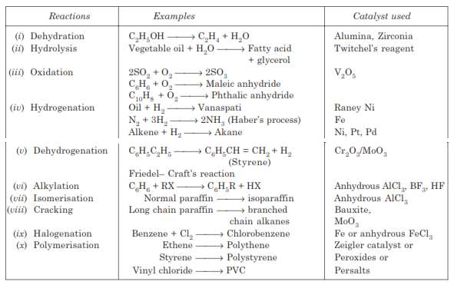
Dr Rameshkumar A/AP Chemistry

Slide 12
Characteristics of catalysts
A catalyst remains unchanged in mass and chemical composition at the end of the reaction.
A small quantity of the catalyst is generally enough
Dr Rameshkumar A/AP Chemistry

Slide 13
Characteristics of catalysts
A catalyst is more effective when finely divided.
A catalyst does not alter the position of the equilibrium state of a reversible reaction.
Catalysts are generally specific in their action.
Dr Rameshkumar A/AP Chemistry

Slide 14
Characteristics of catalysts
The catalyst exhibits maximum activity at a particular temperature which is known as optimum temperature. Change of temperature alters the rate of a catalytic reaction as it would do for the same reaction without a catalyst.
Dr Rameshkumar A/AP Chemistry

Slide 15
BENEFITS AND LIMITATIONS OF CATALYSIS
Homogeneous catalysis is highly reactive and selective, but separation of products from the catalyst remains challenging due to the homogeneity of the mixture.
Heterogeneous catalysts are less reactive and selective, but the products are relatively easy to separate from the catalyst.
Biocatalysts can be highly selective but typically have shorter lifetimes than other types of catalysts.
Dr Rameshkumar A/AP Chemistry

